Slide 1
Customer Default Rate Analysis
Analysis of Customer Default Rate of a Bank using MS Excel Pivot

Slide 2
What is Customer Default Rate in any bank?
Customer default rate analysis is a process used by businesses, particularly those involved in lending or providing credit, to assess the likelihood that their customers will default on their financial obligations. This analysis involves evaluating historical data, financial indicators, and other relevant factors to determine the probability of customers failing to repay loans or fulfill their contractual obligations.

Slide 3
What to do ?
Analyzing default rates and identifying potential risk factors.
Default rates across different purposes.
Default rates trends over quarters.
Rates by tenor band and source.
Visualizations that help in understanding default rates and potential risk factors affecting loan performance.

Slide 4
Analysis of Default Rate using different Purposes and Quarters provided in data using Excel – Pivot Table
QTR | Count of Default
Q-1 | 1987
No | 1505
Yes | 482
Q-2 | 1766
No | 1385
Yes | 381
Q-3 | 2411
No | 1981
Yes | 430
Q-4 | 3972
No | 3330
Yes | 642
Grand Total | 10136
Purposes | Count of Default
Commercial | 1777
No | 1379
Yes | 398
Non Commercial | 8359
No | 6822
Yes | 1537
Grand Total | 10136
There is more default rate in Non Commercial Purpose (aprrox. 4 times)
There is highest default rate in 4th QTR and lowest default rate in 2nd QTR

Slide 5
Default Rate by Tenor Band and Source
Row Labels | Count of Default
Direct | 1882
A.<=12 Months | 88
B. > 12 & <=24 Months | 279
C. > 24 And <= 36 Months | 851
D. > 36 And <= 48 Months | 274
E. > 48 Months | 390
Non Direct | 8254
A.<=12 Months | 57
B. > 12 & <=24 Months | 477
C. > 24 And <= 36 Months | 3769
D. > 36 And <= 48 Months | 1861
E. > 48 Months | 2090
Grand Total | 10136
There is 4 times of default rate in Non Direct source than Direct source
E. > 48 Months Tenor Band have highest Default Rate

Slide 6
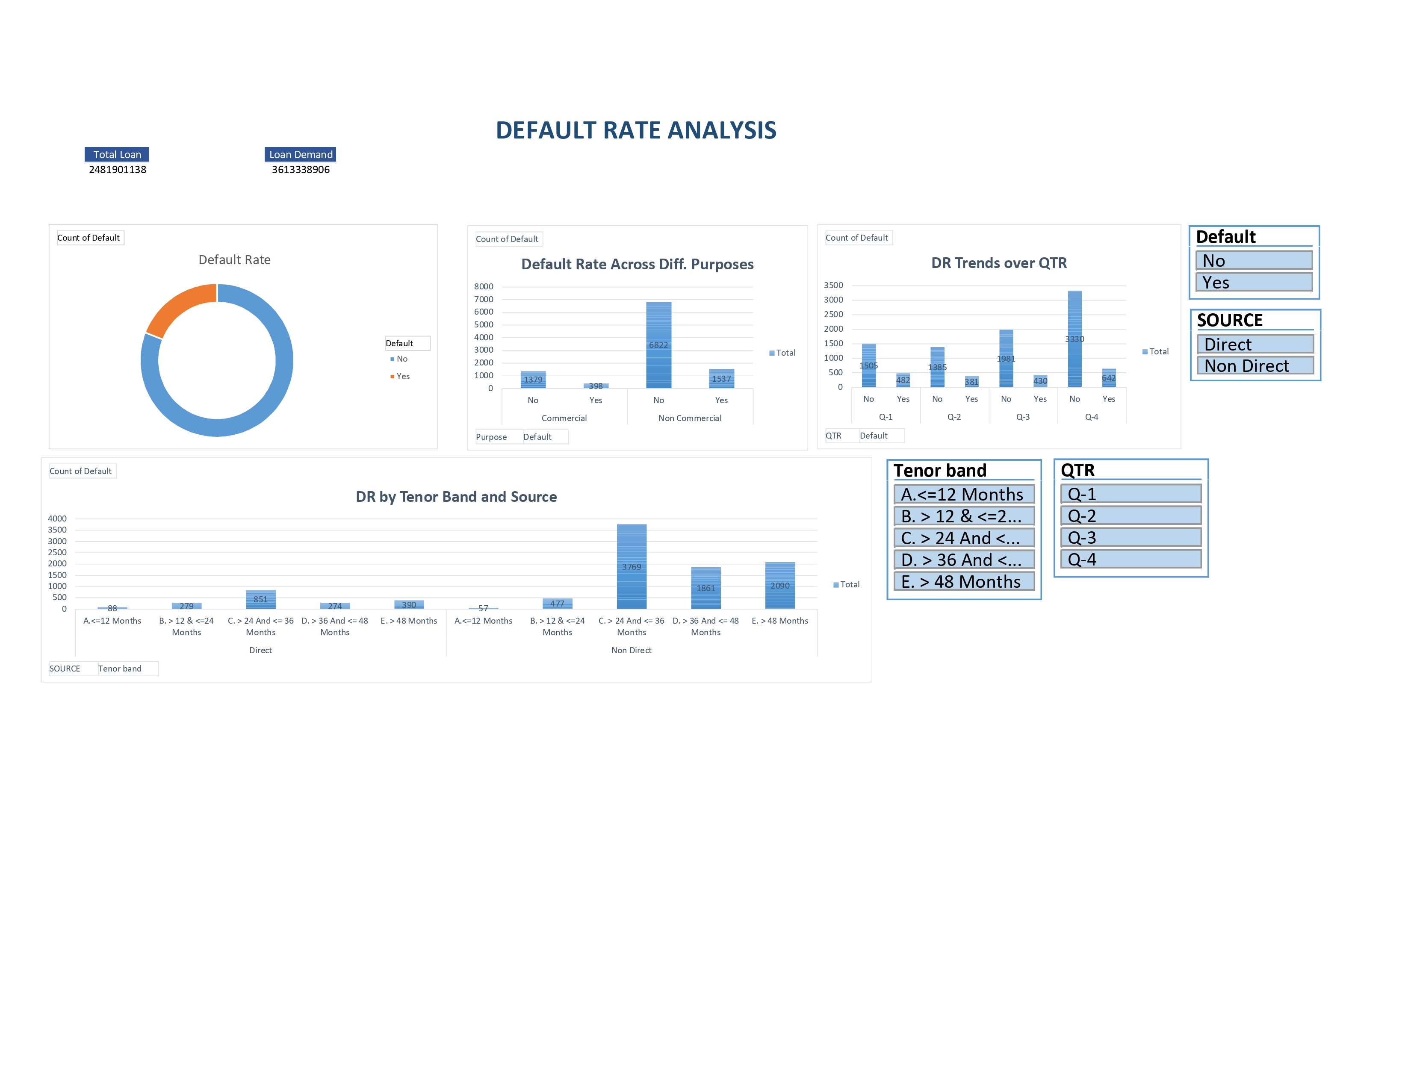
DEFAULT RATE DASHBOARD
So, here is the default rate dashboard containing different slicers and pivot tables

Slide 7
THANK YOU
SHIVAM RATHORE

